Slide 1
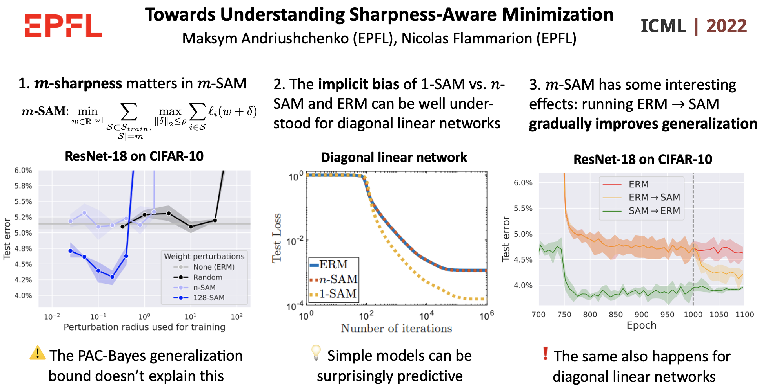

joint work with
Prof. Nicolas Flammarion
28 October 2022
ELLIS Mathematics of Deep Learning reading group

Slide 2
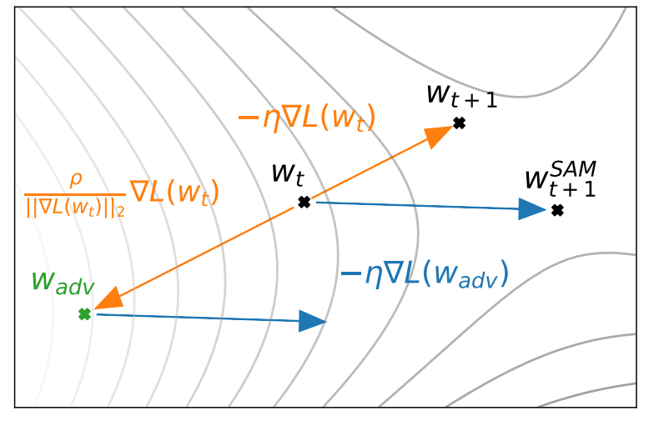
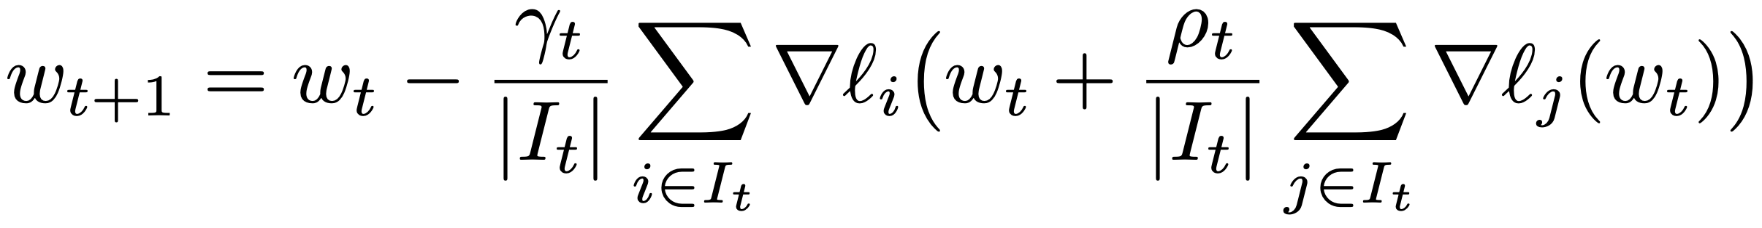
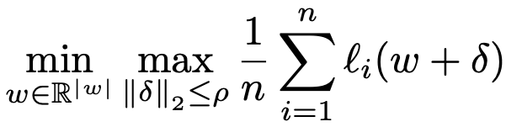
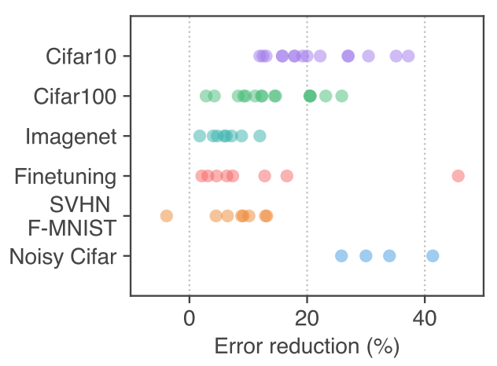
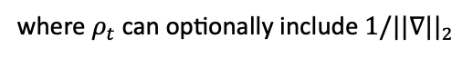
Background: Sharpness-Aware Minimization
Visual description of the SAM algorithm
Sharpness-Aware Minimization (SAM) [Foret et al., ICLR’21]:
where $ρ_{t}$ can optionally include ${1/||∇||}_{2}$
Foret et al., ICLR’21 motivate SAM by minimization of sharpness:
Source: Foret et al, ICLR’21
SAM consistently improves generalization in the state-of-the-art settings (!) and has only 2x computational overhead

Slide 3
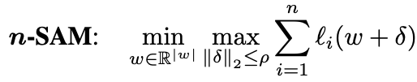
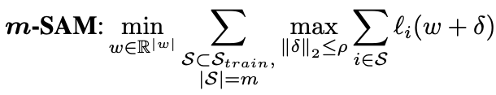
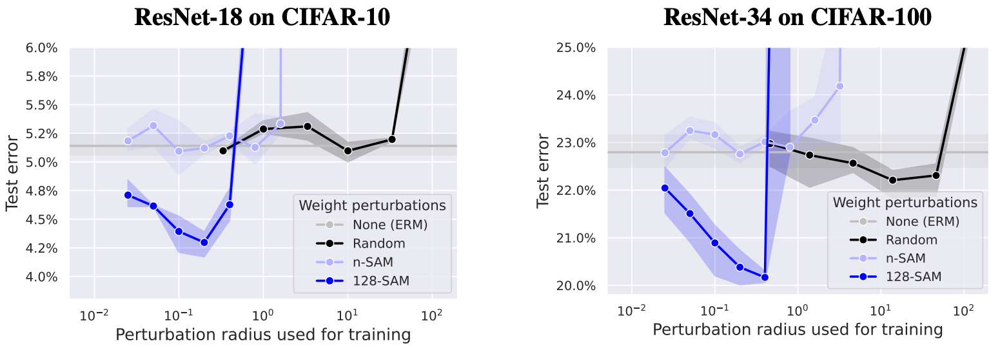
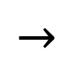
Which components of SAM are crucial?
$$→$$
Worst-case weight perturbations, with a small $m$ (aka $m$-sharpness) are key!
Note: state-of-the-art setting with weight decay, BatchNorm, and data augmentation

Slide 4
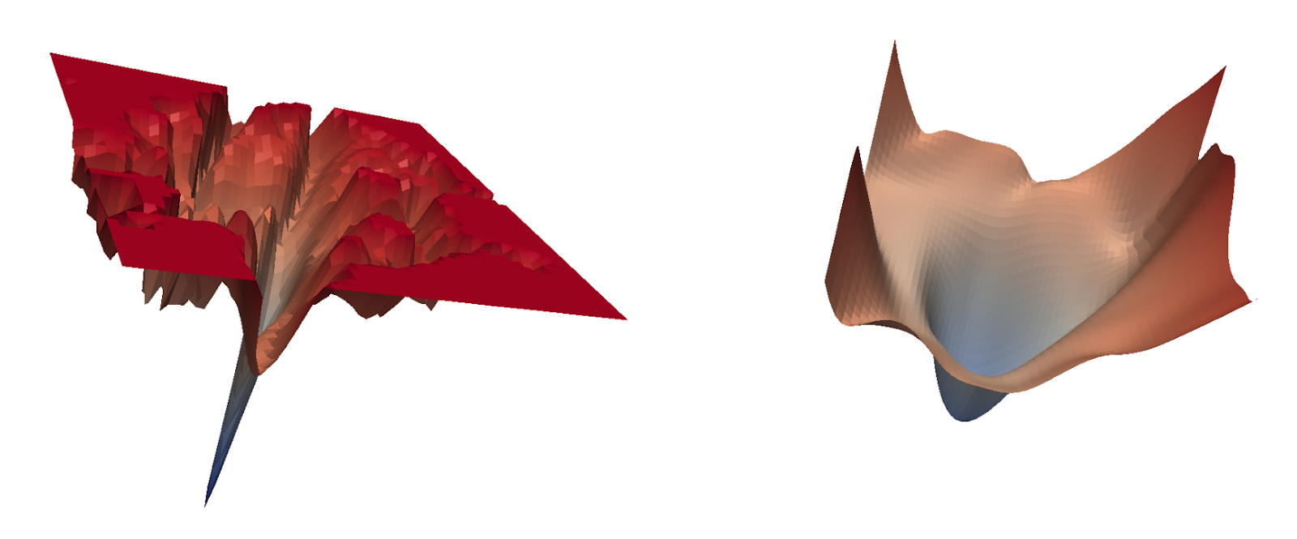
Sharp minima vs. flat minima?
2D subspace around an
ERM minimum
2D subspace around a
SAM minimum
🤔
Source of the loss surfaces: Sharpness-Aware Minimization for Efficiently Improving Generalization, ICLR’21
Importance of $m$-sharpness $⇒$ the common intuition about the benefits of converging to flat minima of the training loss landscape is unlikely to explain SAM!

Slide 5
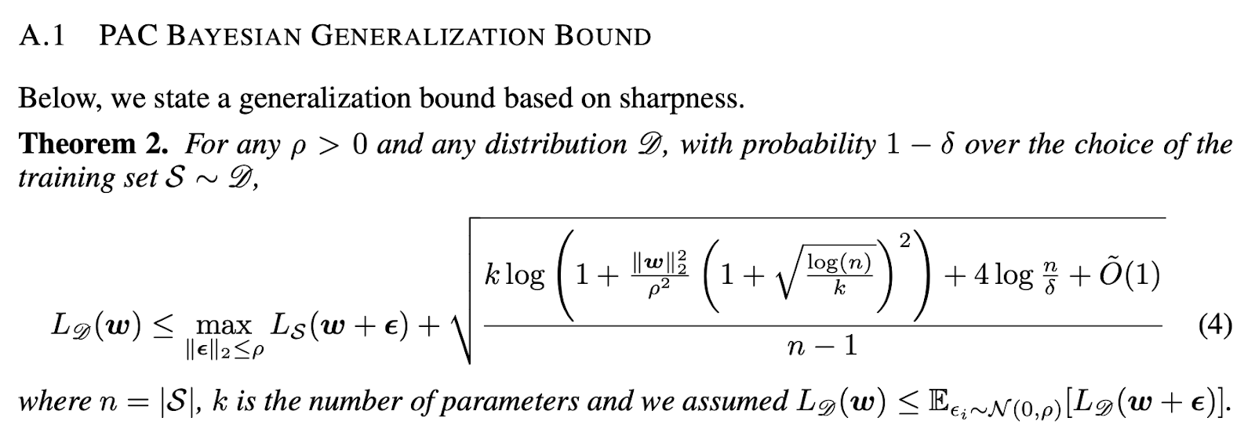
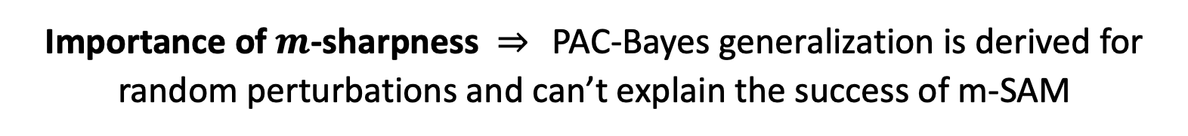
PAC-Bayesian generalization bound and SAM?
🤔
Source: Sharpness-Aware Minimization for Efficiently Improving Generalization, ICLR’21
Importance of $m$-sharpness $⇒$ PAC-Bayes generalization is derived for random perturbations and can’t explain the success of m-SAM

Slide 6
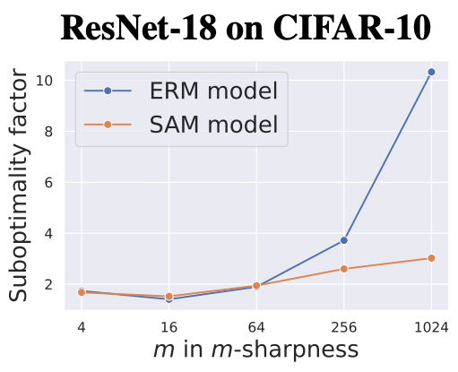
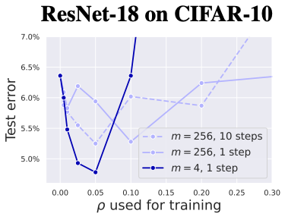
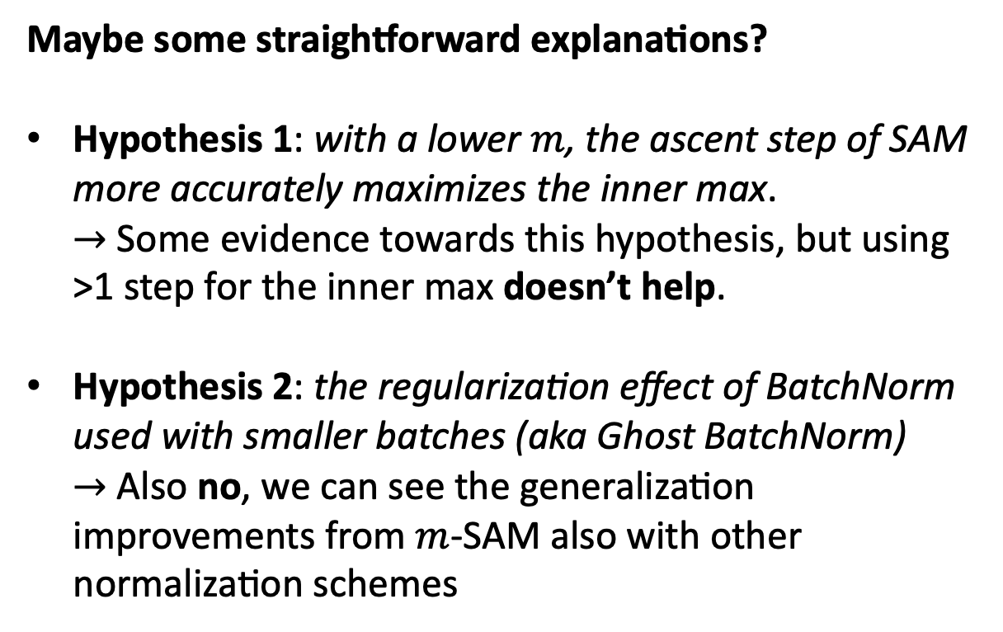
So why can $m$-sharpness be helpful in $m$-SAM?
Maybe some straightforward explanations?
Hypothesis 1: with a lower $m$, the ascent step of SAM more accurately maximizes the inner max. $→$ Some evidence towards this hypothesis, but using >1 step for the inner max doesn’t help.
Hypothesis 2: the regularization effect of BatchNorm used with smaller batches (aka Ghost BatchNorm) $→$ Also no, we can see the generalization improvements from $m$-SAM also with other normalization schemes

Slide 7
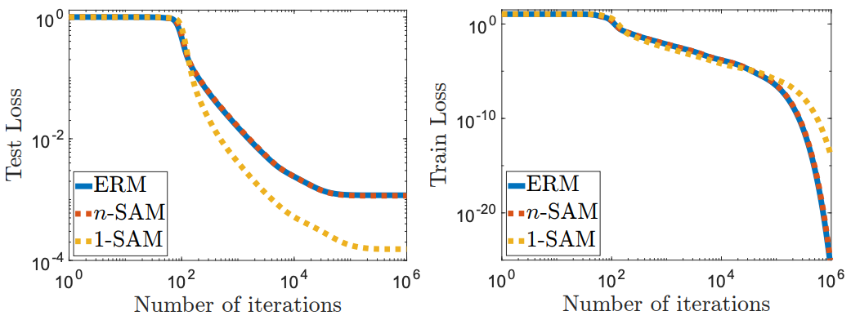

Our approach: understanding $m$-SAM on simple models
We will use diagonal linear networks $f\left(x\right)=⟨x, u⊙v⟩$ for sparse regression that shows different generalization depending on the initialization scale and SGD noise
$1$-SAM for $f(x)$ generalizes significantly better than ERM and $n$-SAM!
We are also able to capture it theoretically: $1$-SAM promotes sparsity in terms of the linear predictor $u⊙v$ (and much more than $n$-SAM) ⬇️

Slide 8
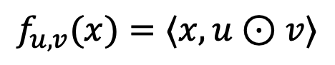
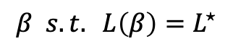
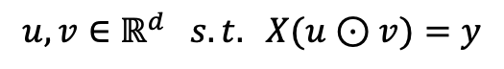
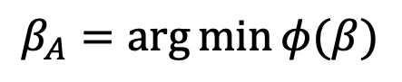
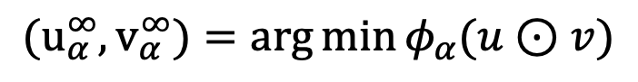
A detour: implicit bias in machine learning
Understanding deep learning requires rethinking generalization (ICLR’17): the key regularization effect for overparametrized networks must come from the opt. algorithm
So what do we mean by the implicit bias? Say, $L^{⋆}$ is an optimal predictor on the training set, then algorithm A induces an implicit bias $φ(β)$ if
$$β_{A}=\arg{\min{φ(β)}}$$
$$β s.t. L\left(β\right)=L^{⋆}$$
For example, for gradient descent on linear models: $φ\left(β\right)={||β−β_{0}||}_{2}$
[Woodworth et al., 2020]: for diagonal linear neural networks (overparam. regression with squared loss) solved with gradient flow, the initialization scale $α$ matters
$$f_{u,v}(x)=⟨x, u⊙v⟩$$
$$(u_{α}^{∞}, v_{α}^{∞})=\arg{\min{φ_{α}(u⊙v)}}$$
$$u, v∈ℝ^{d} s.t. X(u⊙v)=y$$

Slide 9
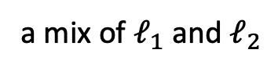
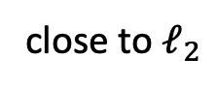
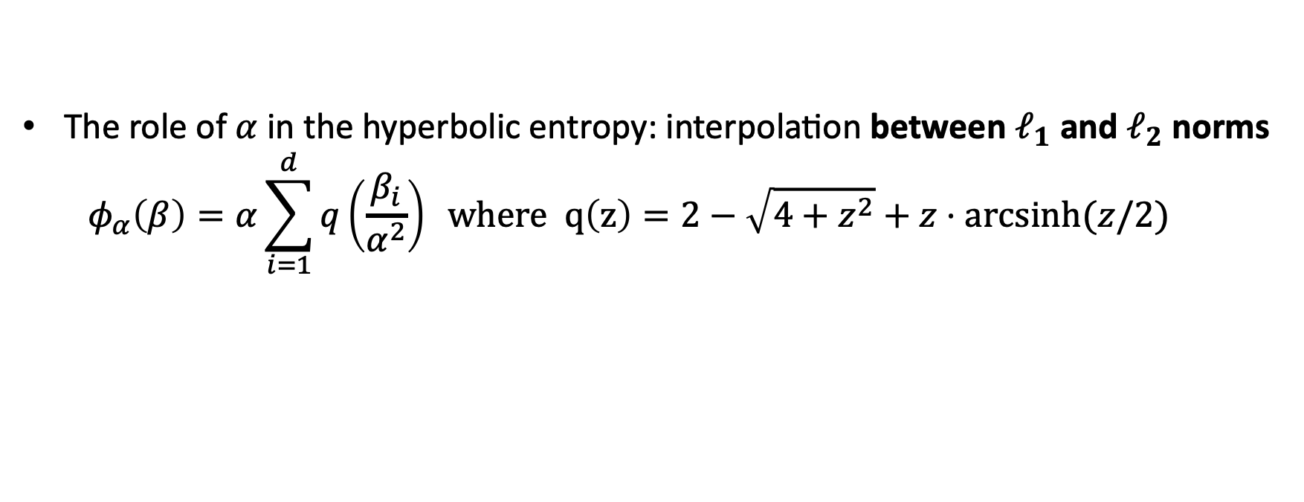
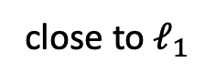
Diagonal linear networks: role of the initialization scale
The role of $α$ in the hyperbolic entropy: interpolation between $ℓ_{1}$ and $ℓ_{2}$ norms
$$φ_{α}\left(β\right)=α\sum_{i=1}^{d}{q\left(\frac{β_{i}}{α^{2}}\right)} where q\left(z\right)=2−\sqrt{4+z^{2}}+z⋅arcsinh⁡(z/2)$$
close to $ℓ_{1}$
a mix of $ℓ_{1}$ and $ℓ_{2}$
close to $ℓ_{2}$

Slide 10
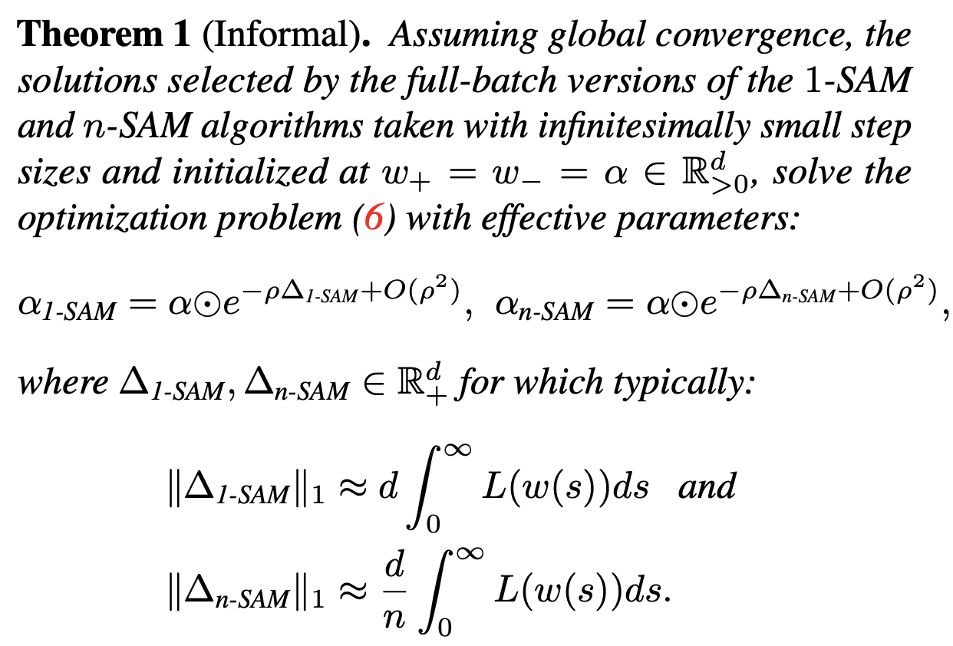
Diagonal linear networks: effect of SAM
Our result for $1$-SAM and $n$-SAM: both decrease the effective parameter $α$ in the hyperbolic entropy $φ_{α}(β)$ but n-SAM reduces it significantly more
So $1$-SAM promotes sparsity of the linear predictor $u⊙v$ (and much more than $n$-SAM)
This implicit bias of SAM can explain its generalization benefits for this problem

Slide 11

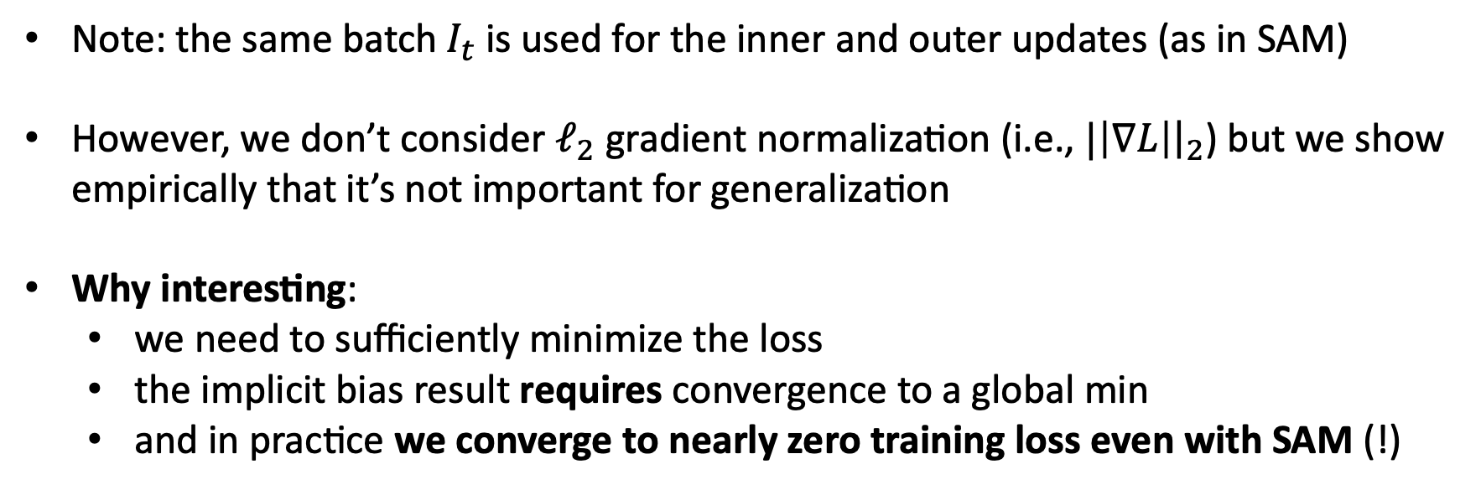
Optimization theory: general convergence results for SAM
We analyze the convergence of the stochastic version of $m$-SAM ($m={|I}_{t}|$):
Note: the same batch $I_{t}$ is used for the inner and outer updates (as in SAM)
However, we don’t consider $ℓ_{2}$ gradient normalization (i.e., $|\left|∇L\right|{\left.​\right|}_{2}$) but we show empirically that it’s not important for generalization
Why interesting:
we need to sufficiently minimize the loss
the implicit bias result requires convergence to a global min
and in practice we converge to nearly zero training loss even with SAM (!)

Slide 12
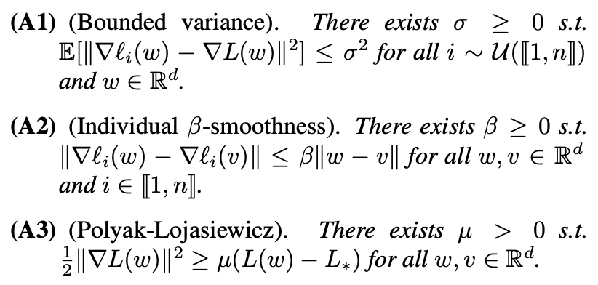
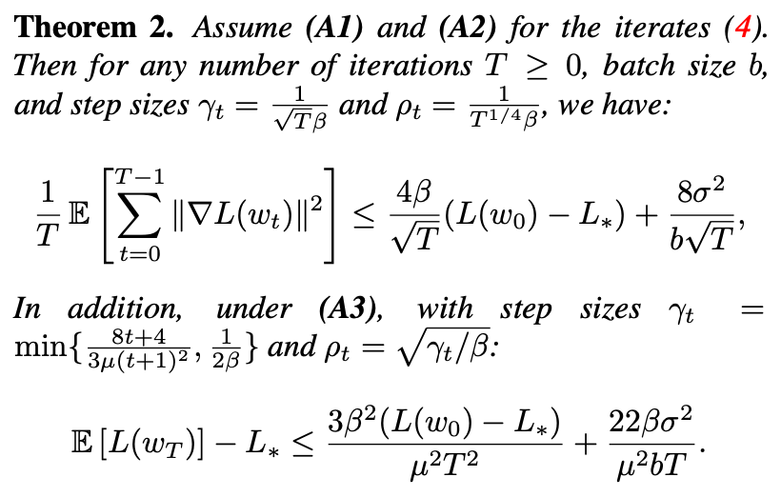

General convergence results for SAM
Assumptions
Convergence theorem
Some people had the intuition that SAM helps generalization because it prevents convergence $→$ not true
Now let’s switch gears and explore the effect of SAM empirically

Slide 13
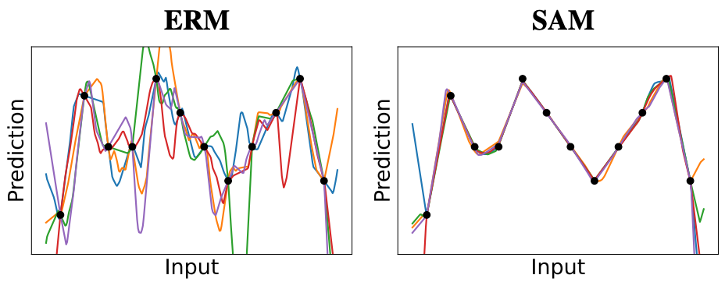
$m$-SAM for 2-layer ReLU networks: sparsity bias
For non-linear networks, we can observe some interesting properties empirically
Using SAM for 2-layer ReLU networks on simple 1D regression also leads to a sparsifying effect but in terms of the ReLU kinks

Slide 14
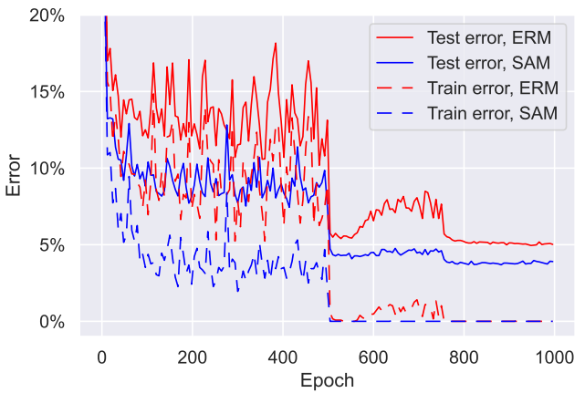
What happens for deep networks: convergence and generalization
Setting: ResNet-18 on CIFAR-10 with data augmentation
Both ERM and SAM converge to nearly zero training loss: 0.0012 for ERM vs 0.0009 for SAM => our convergence result is relevant
However, the SAM model has much better generalization performance: 3.76% vs 5.03% test error

Slide 15
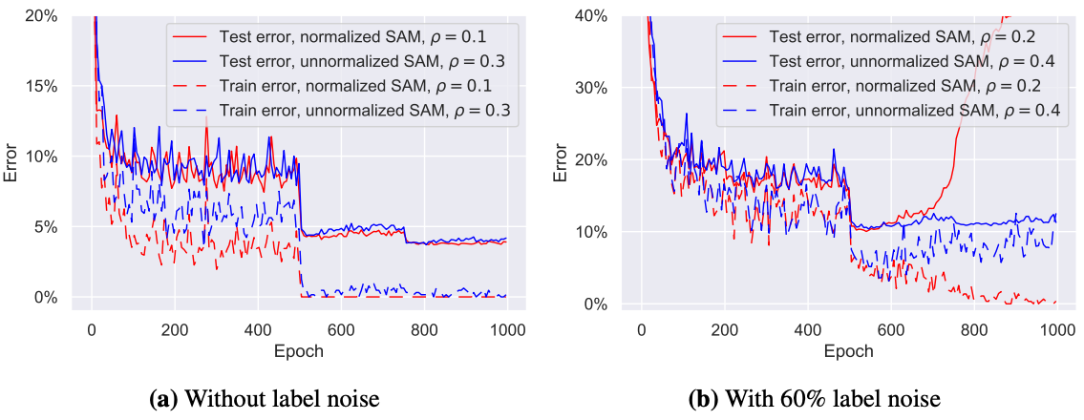
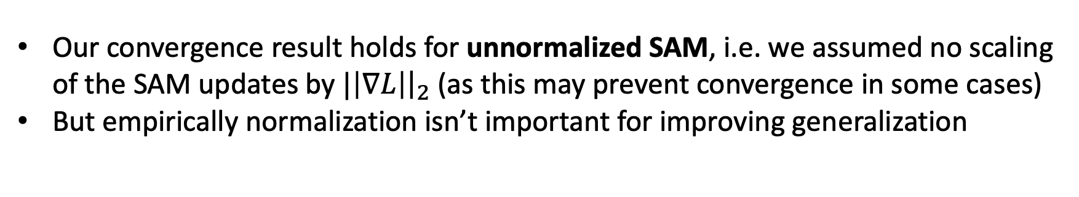
What happens for deep networks: normalization in SAM
Our convergence result holds for unnormalized SAM, i.e. we assumed no scaling of the SAM updates by $|\left|∇L\right|{\left.​\right|}_{2}$ (as this may prevent convergence in some cases)
But empirically normalization isn’t important for improving generalization

Slide 16
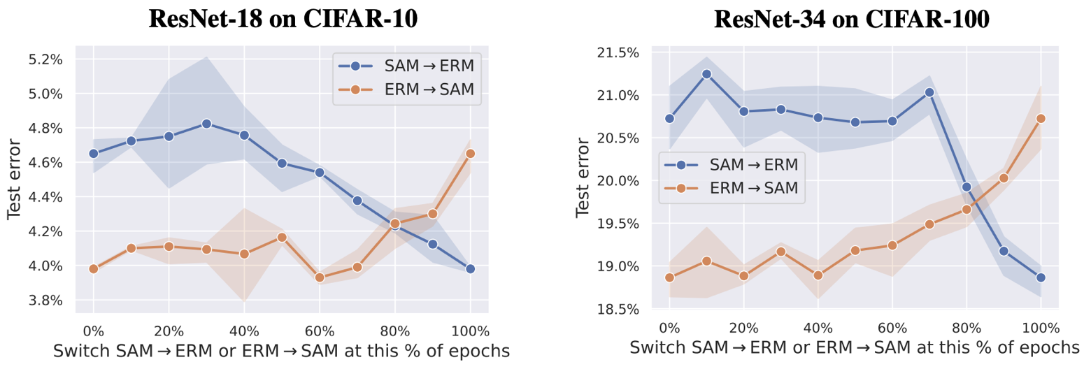
At which stage of training the effect of SAM is important? (part I)
Here we switch from SAM to ERM and from ERM to SAM at different stages of training
$→$ SAM has the most important effect in the second half of the training

Slide 17
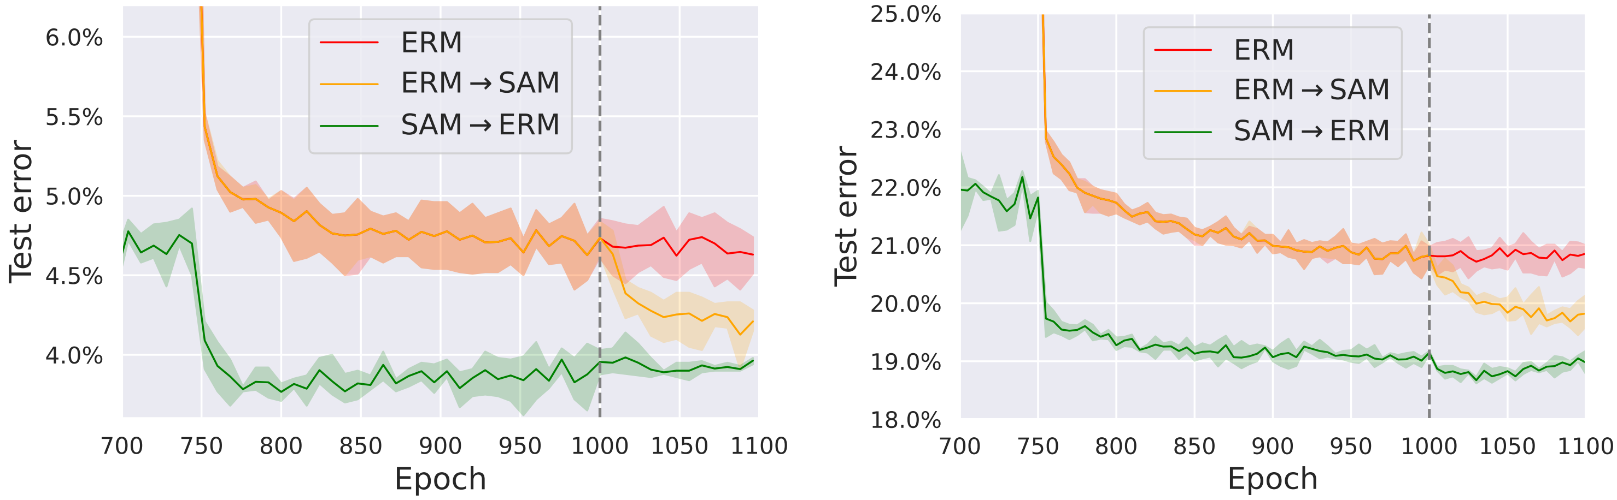
At which stage of training the effect of SAM is important? (part II)
A curious property of SAM: if we finetune an ERM model with SAM on the same dataset, we get a significant generalization improvement
ResNet-18 on CIFAR-10
ResNet-34 on CIFAR-100
+ minima of ERM and ERM$→$SAM are linearly connected
And it’s not so mysterious: exactly the same phenomena are observed also for diagonal linear networks where we can explain the dynamics quite well!

Slide 18
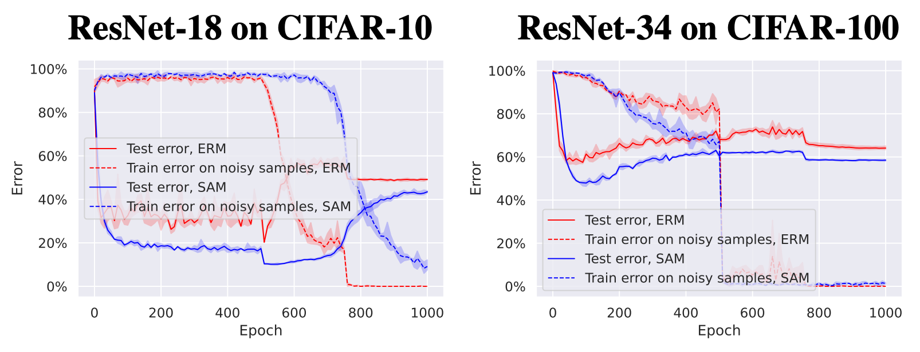
What happens with SAM on mislabelled data?
Convergence of SAM to global minima can also have a negative impact $→$ e.g., SAM overfits similarly to ERM when trained on mislabelled data
ResNet-18 on CIFAR-10
ResNet-34 on CIFAR-100
This also suggests that the beneficial effect of SAM is observed not only close to a minimum but also along the whole optimization trajectory

Slide 19
Future directions
What is the implicit bias of SAM for non-linear neural networks in terms of the learned function?
Why does sharpness still makes sense despite its obvious flaws (Sharp Minima Can Generalize For Deep Nets (ICML’17))?
Why is SAM so beneficial for vision transformers: When Vision Transformers Outperform ResNets without Pre-training or Strong Data Augmentations (ICLR’22)?
More in-depth exploration of SAM in the noisy label setting: why does it work?
Before we conclude, a few more words about 1.

Slide 20
A follow-up on the sparsity observation
This observation is quite curious. Can we understand it better? Can the same effect be achieved with standard SGD?

Slide 21
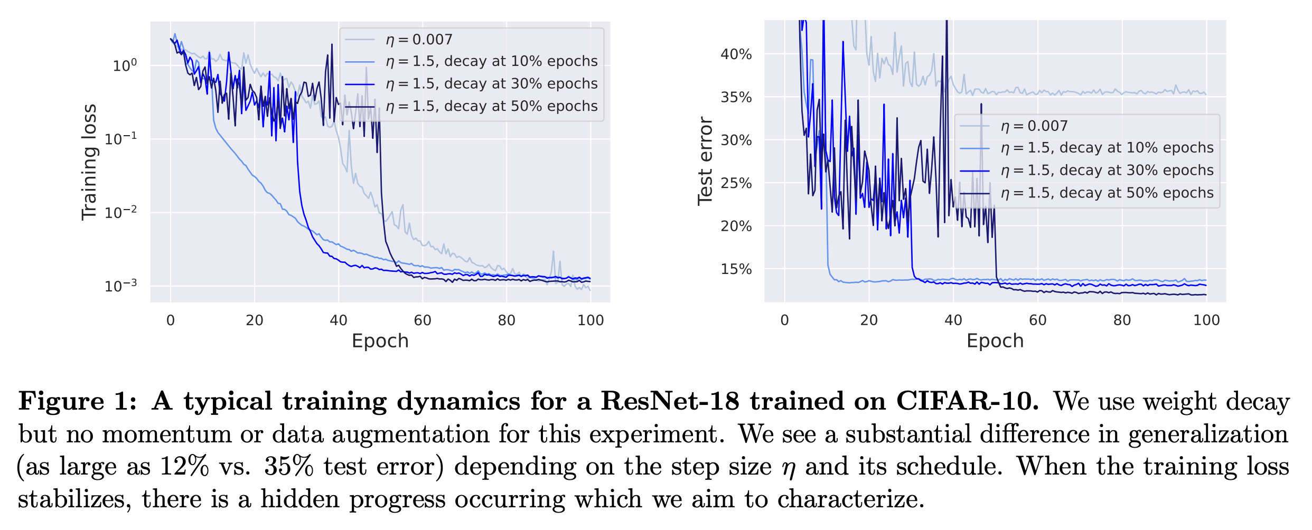
New paper: SGD with large step sizes learns sparse features
A typical training dynamics for a ResNet-18 on CIFAR-10
Setting: no momentum, no data augmentation.
Why does the training loss stabilizes?
What kind of hidden dynamics is happening in this phase?
Is it related to sparsity of the predictor?

Slide 22
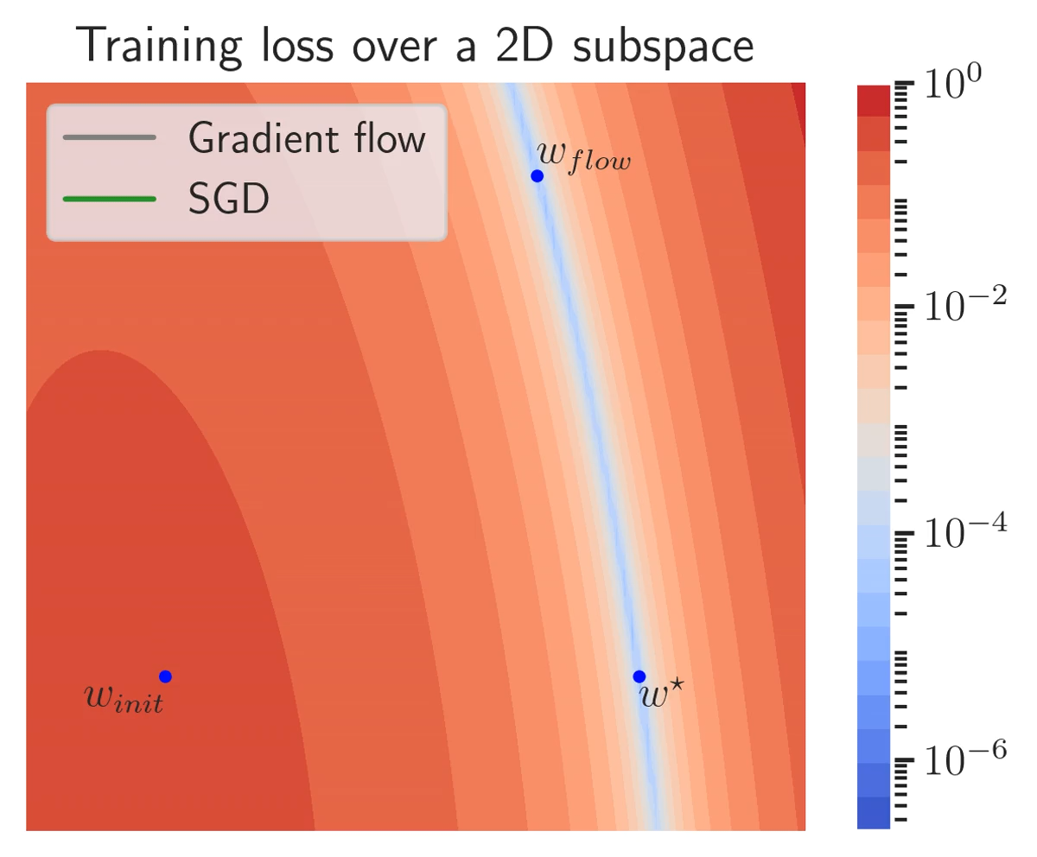
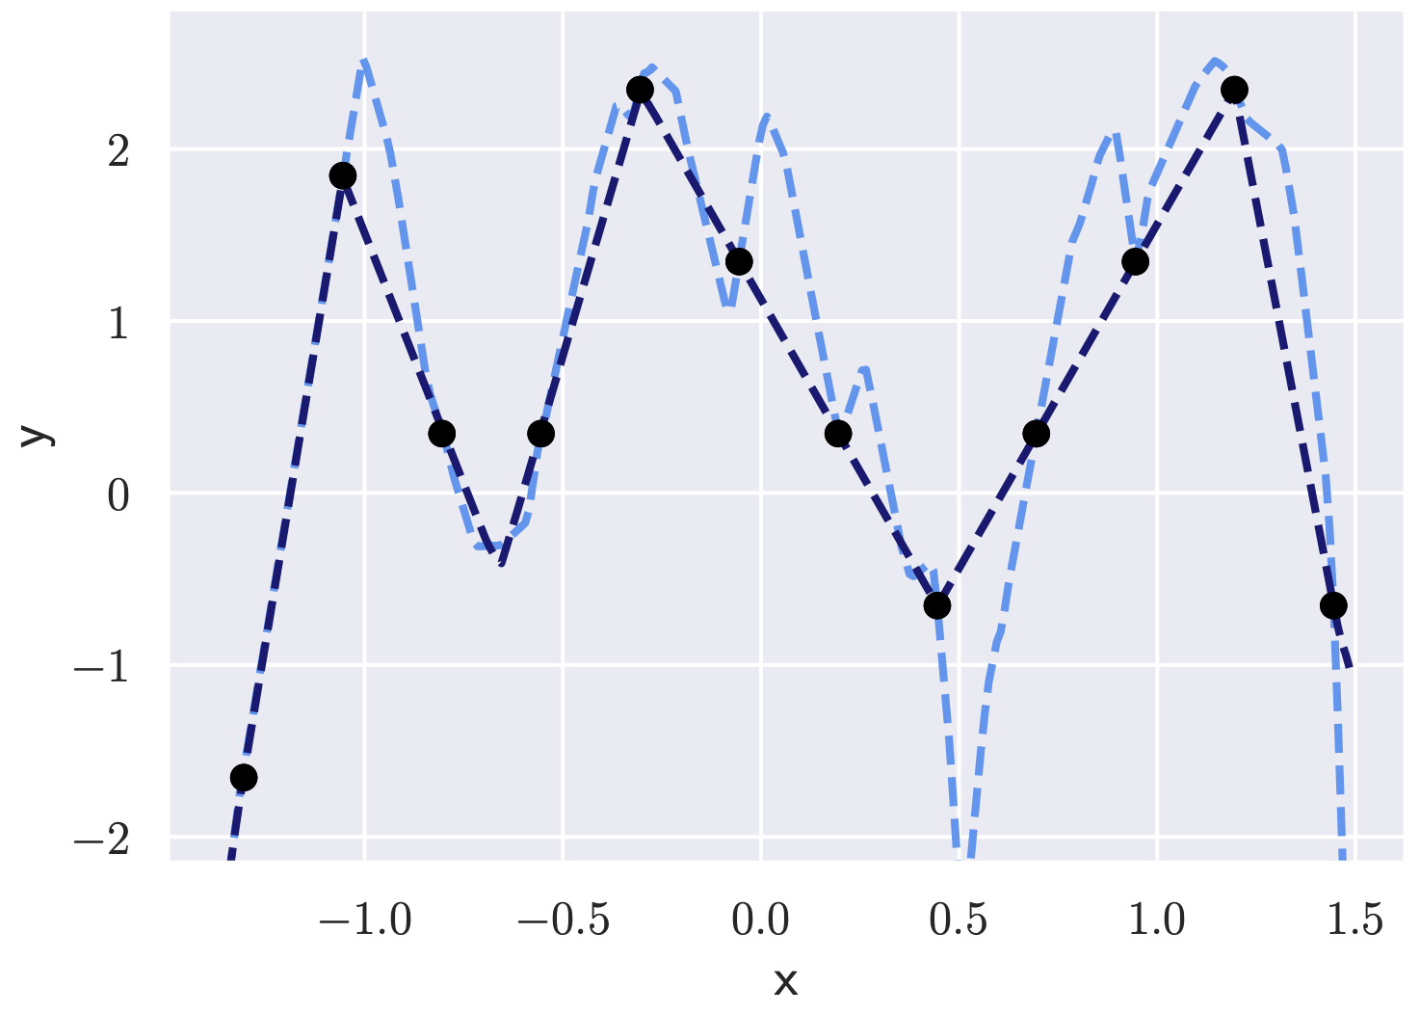
New paper: SGD with large step sizes learns sparse features
Our picture: SGD noise drives the iterates to a sparse solution which we observe on many models (from diagonal linear networks to ResNets on CIFAR-100)
It’s important that we don’t converge too early and keep benefitting from the noise
Relation to sharpness: the slow noisy dynamics can be seen as minimization of some sharpness-related criterion (but unclear which exactly; rank of the NTK feature matrix seems to be a good proxy)

Slide 23
Thanks for your attention!
Happy to answer your questions and chat more :)
Paper: https://arxiv.org/abs/2206.06232
Code: https://github.com/tml-epfl/understanding-sam

